Slide 1
IT 304 Computer Networks Autumn 2022
Instructor: Kalyan Sasidhar P S
Associate Professor, FB 2109
kalyan_sasidhar@daiict.ac.in

Slide 2
Course Logistics
Experience
Batch taught | Years
MSc IT | 2016-2020
BTech | 2017, 2021
Timings
Monday 11-11:50 AM
Wed 9-9:50 AM
Fri 8-8:50 AM
Philosophy
Attend and pay attention
No MARKS/GRADE negotiations
Textbooks:
Computer Networking: A Top-Down Approach 7th edition, Jim Kurose, Keith Ross
Computer Networks: A Systems Approach, 5th Edition, Larry Peterson and Bruce Davie
Component | Percentage
In-Sem I | 15
In-Sem II | 20
Labs | 25
End sem | 40

Slide 3
Goal
Learn concepts underlying networks
How do networks work? What can one do with them?
Gain a basic understanding of the Internet
Gain experience writing protocols
Tools to understand new protocols and applications
Teach your Grandparents WHAT IS INTERNET

Slide 4
What comes to your mind, when I say …..
INTERNET
World Wide Web
IT 304

Slide 5
https://localiq.com/blog/what-happens-in-an-internet-minute/

Slide 6
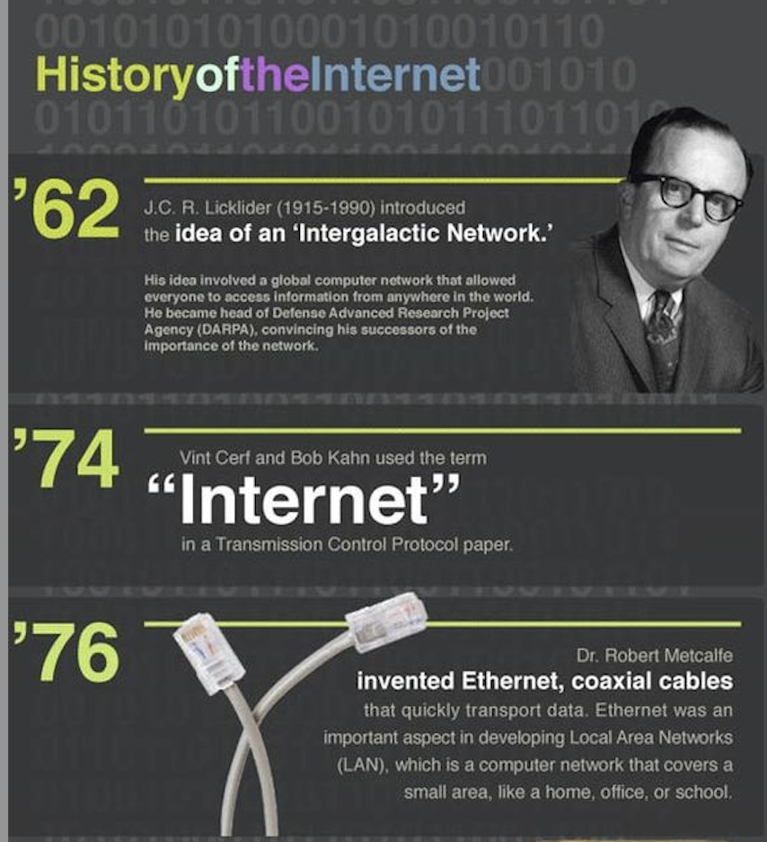
Vincent Cerf
Tim Berners Lee
Paul Baran
JCR LickLider
https://www.history.com/topics/inventions/invention-of-the-internet
https://www.computerhistory.org/timeline/networking-the-web/

Slide 7
Chapter 1: Introduction
our goal:
get “feel” and terminology
more depth, detail later in course
approach:
use Internet as example
overview:
History
What’s the Internet?
What’s a protocol?
Network edge; hosts, access net, physical media
network core: packet/circuit switching, Internet structure
performance: loss, delay, throughput
security
protocol layers, service models

Slide 8
Chapter 1: roadmap
1.1 history
1.2 what is the Internet?
1.3 network edge
end systems, access networks, links
1.4 network core
packet switching, circuit switching, network structure
1.5 delay, loss, throughput in networks
1.6 protocol layers, service models

Slide 9
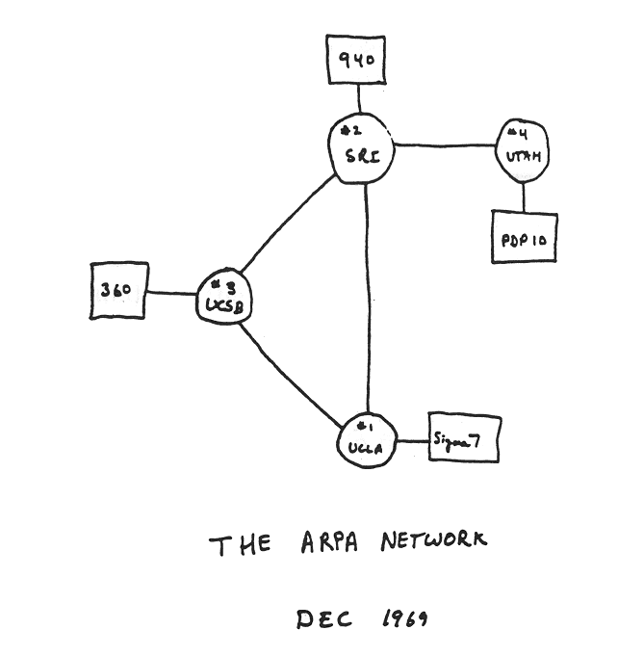
Internet history
1961-1972: Early packet-switching principles
1961: Kleinrock - queueing theory shows effectiveness of packet-switching
1964: Baran - packet-switching in military nets
1967: ARPAnet conceived by Advanced Research Projects Agency
1969: first ARPAnet node operational
1972:
ARPAnet public demo
NCP (Network Control Protocol) first host-host protocol
first e-mail program
ARPAnet has 15 nodes

Slide 10

Internet history
1972-1980: Internetworking, new and proprietary nets
1970: ALOHAnet satellite network in Hawaii
1974: Cerf and Kahn - architecture for interconnecting networks
1976: Ethernet at Xerox PARC
late70’s: proprietary architectures: DECnet, SNA, XNA
late 70’s: switching fixed length packets
1979: ARPAnet has 200 nodes
Cerf and Kahn’s internetworking principles:
minimalism, autonomy - no internal changes required to interconnect networks
best effort service model
stateless routers
decentralized control
define today’s Internet architecture

Slide 11

Internet history
1980-1990: new protocols, a proliferation of networks
1983: deployment of TCP/IP
1982: smtp e-mail protocol defined
1983: DNS defined for name-to-IP-address translation
1985: FTP protocol defined
1988: TCP congestion control
new national networks: Csnet, BITnet, NSFnet, Minitel
100,000 hosts connected to confederation of networks

Slide 12

Internet history
1990, 2000’s: commercialization, the Web, new apps
early 1990’s: ARPAnet decommissioned
1991: NSF lifts restrictions on commercial use of NSFnet (decommissioned, 1995)
early 1990s: Web
hypertext [Bush 1945, Nelson 1960’s]
HTML, HTTP: Berners-Lee
1994: Mosaic, later Netscape
late 1990’s: commercialization of the Web
late 1990’s – 2000’s:
more killer apps: instant messaging, P2P file sharing
network security to forefront
est. 50 million host, 100 million+ users
backbone links running at Gbps

Slide 13
Internet history
2005-present
~750 million hosts
Smartphones and tablets
Aggressive deployment of broadband access
Increasing ubiquity of high-speed wireless access
Emergence of online social networks:
Facebook: soon one billion users
Service providers (Google, Microsoft) create their own networks
Bypass Internet, providing “instantaneous” access to search, emai, etc.
E-commerce, universities, enterprises running their services in “cloud” (eg, Amazon EC2)

Slide 14
INTERNET

Slide 15
What is a network?

Slide 16
A Network is…..
All the components (H/W & S/W) involved in connecting computer across small and large distances
Importance of Networks:
Easy access and sharing of information
Sharing of expensive devices and network
resources
Modern Technologies (IP telephony, Video
on Demand, ….etc)

Slide 17
What are all part of a network?

Slide 18
Network components
Network has three main components
Computers (servers and hosts)
- Source of applications (network aware applications)
- ex: HTTP (Hyper Text Transmission Protocol),
FTP (File Transfer Protocol),
SNMP (Simple Network Management Protocol)
Telnet
Network Devices
- Devices that interconnect different computers together
- ex: Repeaters, hub, bridge, switch, router, NIC and modems
Connectivity
- Media that physically connect the computers and network devices
- ex: Wireless and cables

Slide 19
Network Types
LAN (Local Area Network):
It is a group of network components that work
within small area
MAN (Metropolitan Area Network):
It is a group of LANs that are interconnected
within small area
WAN (Wide Area Network):
It is a group of LANs that are interconnected
within large area

Slide 20
What’s the Internet: “nuts and bolts” view

Slide 21
What is the use of Internet?

Slide 22
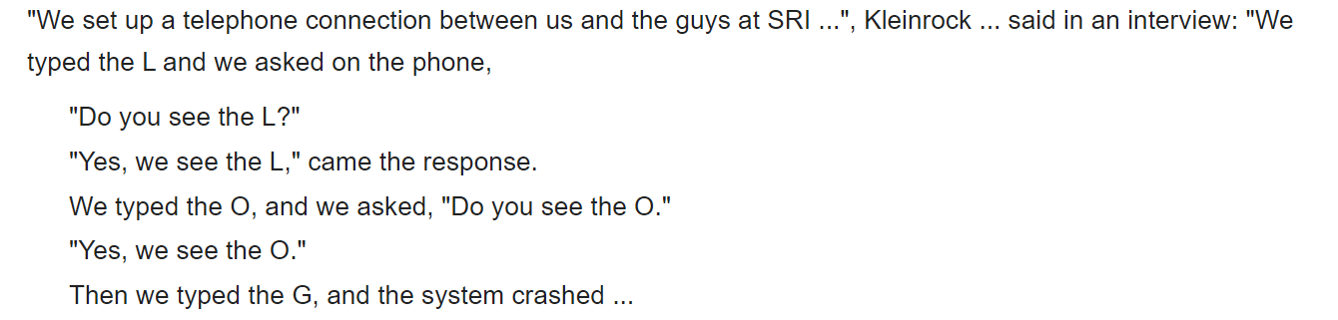

Slide 23
https://www.youtube.com/watch?v=p5mASvEvDZc

